Slide 1

TRAINING MODULE FOR 120 COOPERATIVE LEADERS
CLIMATE CHANGE IMPACTS ON LIVESTOCK
Sustainable Grazing Practices •Feed and Water Management •Environmental Stewardship
ORGANIZED BY
YABI RURAL DEVELOPMENT INITIATIVE (YABIRDI)
IN COLLABORATION WITH;
LIVESTOCK PRODUCTIVITY AND RESILIENCE SUPPORT PROJECT (L-PRESS),
YOBE STATE
Dr Muhammed Malah
+2348084601746

Slide 2


About This Training
Climate change is one of the most pressing challenges of the 21st century, already reshaping livestock production across sub-Saharan Africa.
Rising temperatures, erratic rainfall, and extreme weather threaten the livelihoods of hundreds of millions who depend on animal agriculture.
This training equips cooperative leaders with practical, science-based strategies for climate-resilient, environmentally sound livestock enterprises.
120
Cooperative leaders across Yobe State's livestock value chain participating in this capacity-building programme
2

Slide 3
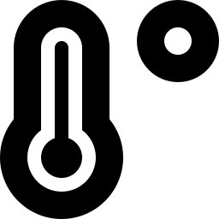




Module Roadmap
Four integrated units plus a digital transformation module
1
2
3
4
+
Climate Change Impacts on Livestock
Sustainable Grazing Practices
Feed and Water Management
Environmental Stewardship
ICT & Digital Transformation
Designed as a coherent framework for climate-resilient livestock production and modern cooperative governance
3

Slide 4

Climate Change Impacts on Livestock
Understanding the science and the direct consequences for animal agriculture

Slide 5
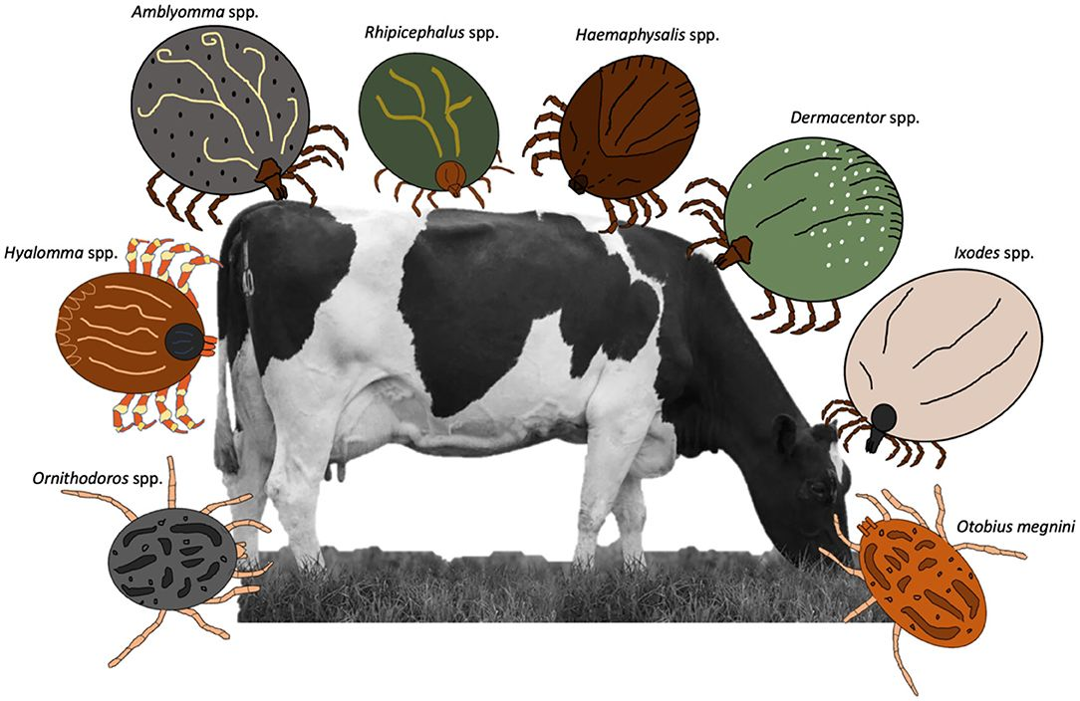
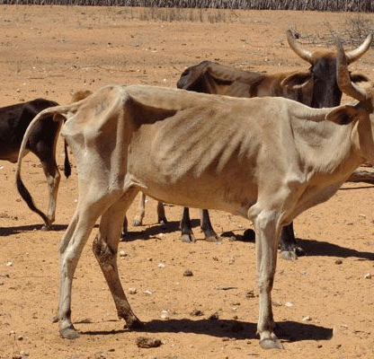
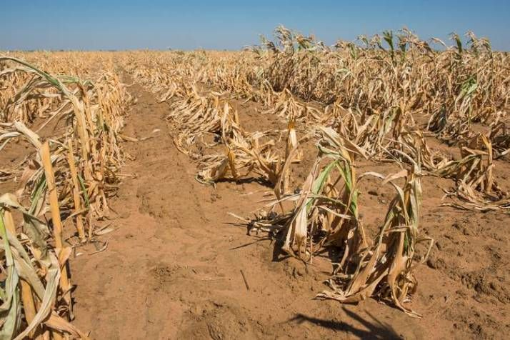
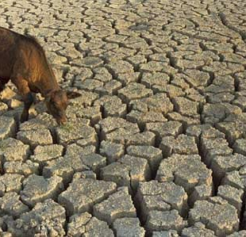
UNIT 1 — FIELD PERSPECTIVE
Climate Change on the Ground
Heat and drought stress leave cattle emaciated and weak
Failed maize crop after prolonged drought reduces feed supply
Cracked, dry earth signals collapsing water and pasture availability
Drought and heat stress translate directly into visible loss of body condition and disease and crop failure
34

Slide 6
Understanding Climate Change
Climate change refers to long-term shifts in global temperatures and weather patterns, driven since the mid-20th century primarily by human activity.
Burning fossil fuels, deforestation, and intensive agriculture release CO₂, methane (CH₄), and nitrous oxide (N₂O), trapping heat in the atmosphere.
Sub-Saharan Africa is warming faster than the global average, with the most severe impacts in arid/semi-arid zones like the Sudan Savannah.
+1.1°C
Global mean surface temperature increase already observed above pre-industrial levels (IPCC)
+1.5 to 4°C
Projected further rise by end of century, depending on future emissions trajectories
6

Slide 7


Heat Stress: The Primary Direct Impact
When ambient temperature exceeds an animal's thermal comfort zone
Cattle (tropical breeds)
Sheep and Goats
Beyond comfort zone → metabolic energy diverts from growth, reproduction, and milk production toward thermoregulation
25–27°C
20–23°C
Thermal comfort zone
Thermal comfort zone
Consequences of Sustained Heat Stress
Feed intake ↓ 10–30%
Milk yield ↓ 10–25%
Impaired reproduction
Suppressed immunity
Increased mortality risk
7

Slide 8
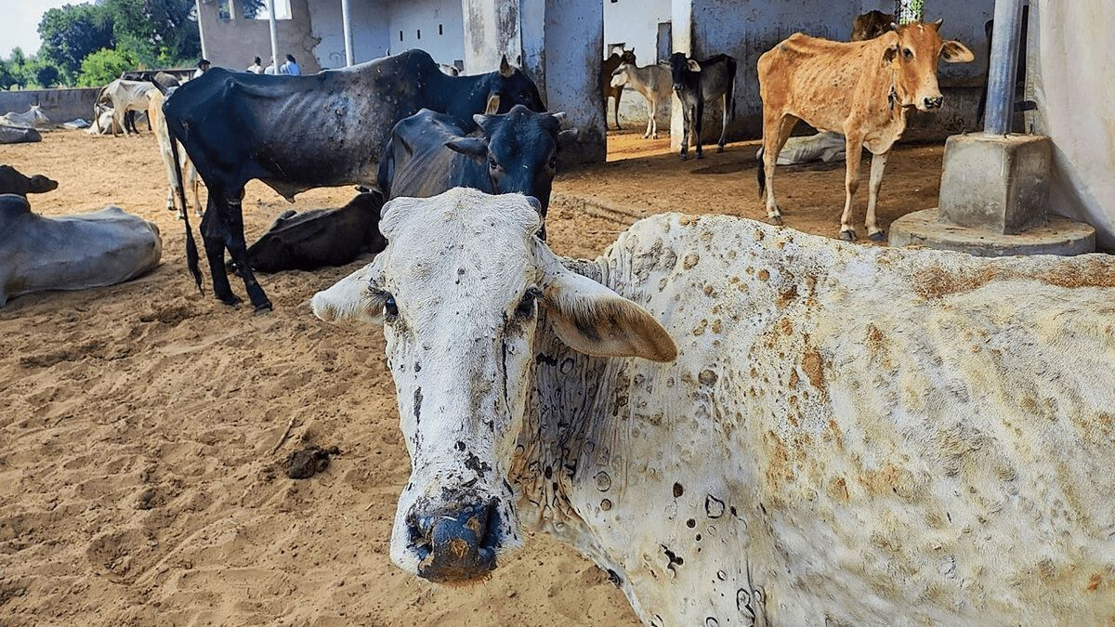

Slide 9



Changing Disease and Parasite Distribution
Warmer, wetter conditions expand the range of livestock disease vectors
Trypanosomiasis
Foot-and-Mouth Disease
Tsetse fly vector expanding northward into previously dry, uninhabited areas
Disrupted seasonal movement patterns increase animal-to-animal contact and spread
Tick-borne Diseases
Respiratory Diseases
East Coast Fever and babesiosis expand as tick populations grow in warmer, wetter conditions
Dust and heat stress weaken respiratory defences, increasing pneumonia incidence
8

Slide 10
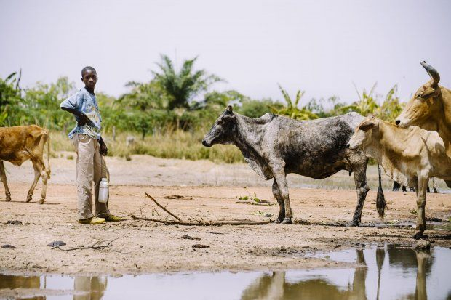
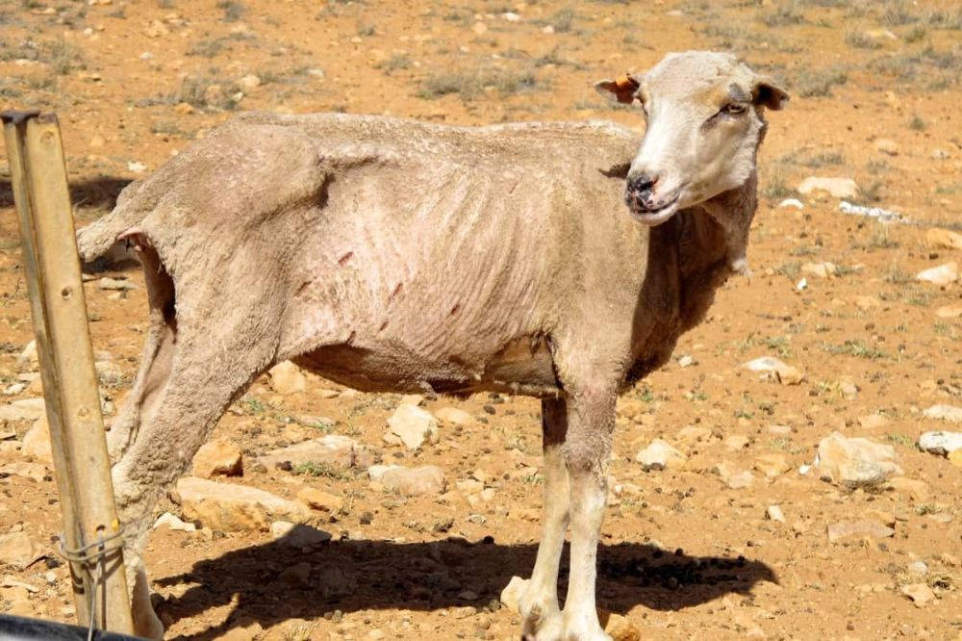
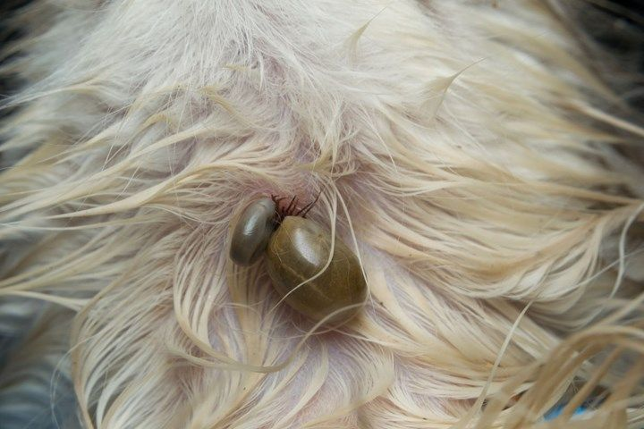
Changing Disease and Parasite Distribution

Slide 11
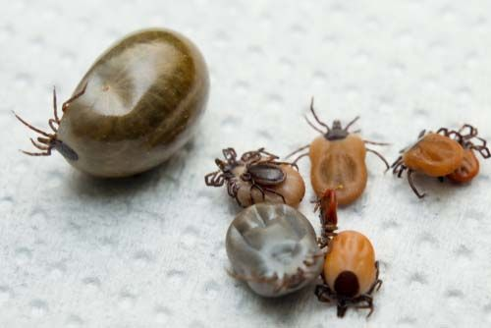
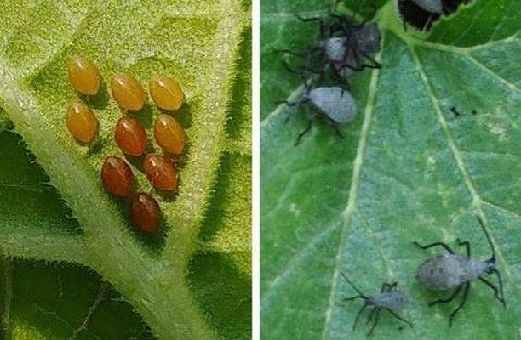
Warmer, wetter conditions expand the range of livestock disease vectors

Slide 12

Impacts on Feed and Water Availability
Reduced pasture biomass
Droughts reduce grass growth and kill perennial pasture species
Shift in species composition
Palatable grasses replaced by unpalatable shrubs and invasive species
Reduced water availability
Rivers, ponds, and boreholes dry up earlier and more frequently
Reduced crop residue
Lower crop yields limit stovers and straws used as dry-season feed
9

Slide 13
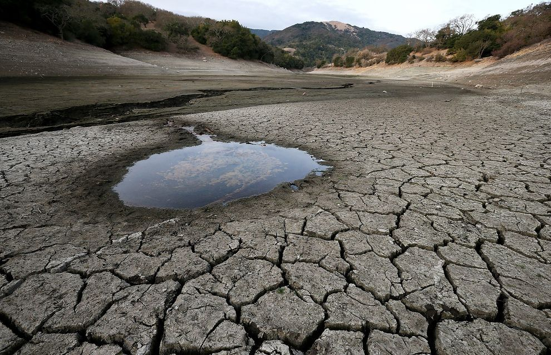
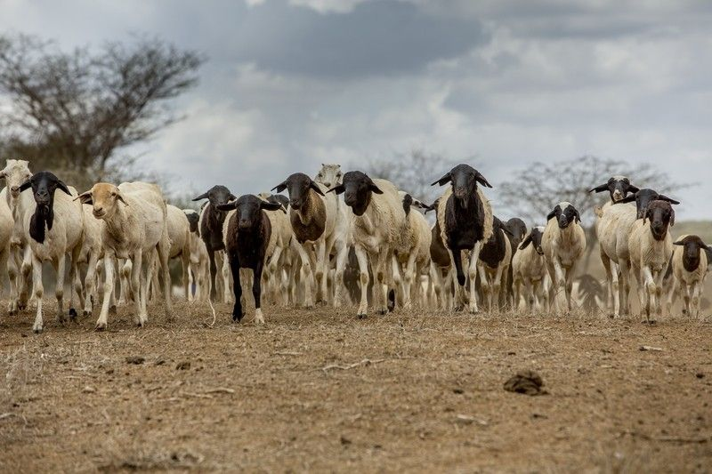
Impacts of climate change on Feed and Water Availability
Lack of grazing pasture and scarcity of water

Slide 14
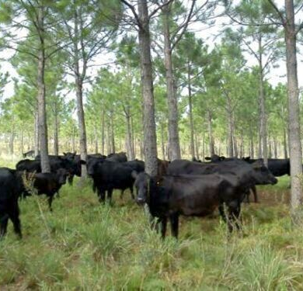
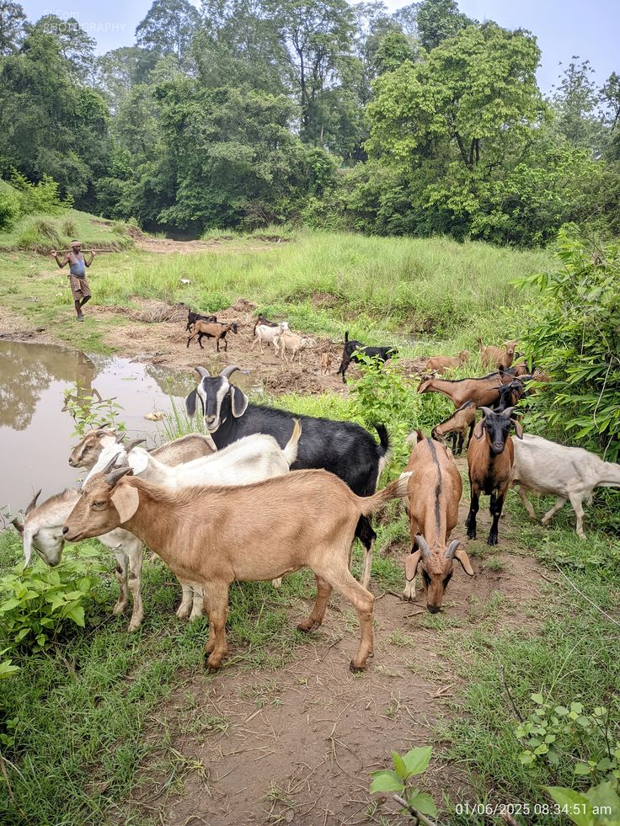
UNIT 2 — FIELD PERSPECTIVE
Grazing Systems in Practice
Silvopastoral grazing: cattle sheltered and fed under tree cover
Overgrazed, degraded rangeland leaves animals in poor condition
Mixed-species herding near water utilises varied vegetation
From degraded rangeland to silvopastoral integration and mixed-species herding
35

Slide 15
UNIT 2
Sustainable Grazing Practices
Managing rangelands to protect long-term productivity under a changing climate

Slide 16
The Overgrazing Problem
When stocking rate exceeds the land's carrying capacity
Loss of vegetative cover
Soil compaction
Invasion by unpalatable species
Reduced water retention
Reduced carbon storage
Bare soil becomes exposed to wind and rain erosion
Animal hooves compact soil, reducing infiltration, increasing runoff
Desirable grasses replaced by thorny shrubs and weeds
Degraded soils hold less water, worsening drought impact
Overgrazing releases stored soil/plant carbon as CO₂
12

Slide 17
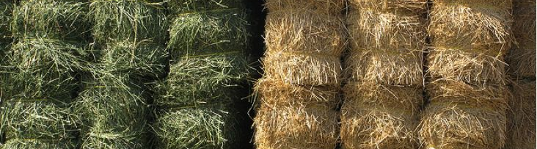
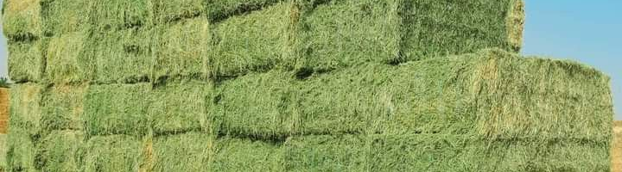
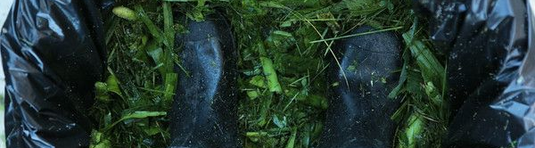
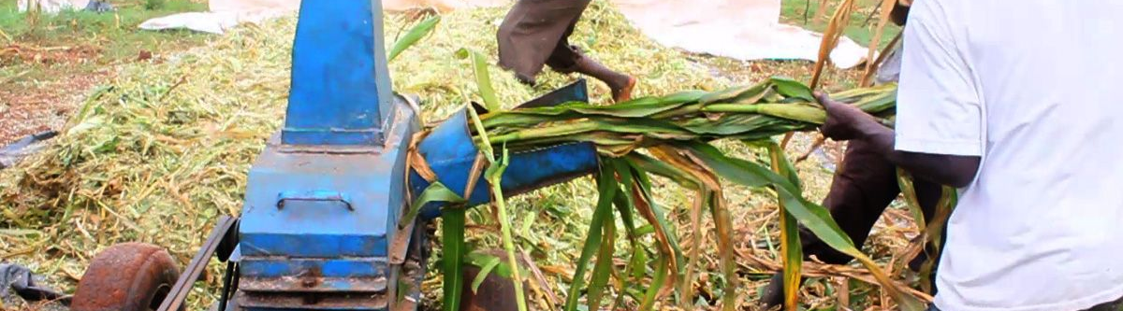
UNIT 3 — FIELD PERSPECTIVE
Feed Conservation in Practice
Fresh (green) and cured (golden) hay bales ready for storage
Large hay bales stacked for dry-season reserves
Chopped green fodder packed for silage fermentation
A chaff cutter processes maize stover into livestock feed
Hay, silage, and residue processing extend feed supply through the dry season
36

Slide 18
Rotational Grazing System
Dividing pasture into paddocks, moved on a planned schedule
Paddock 1
Grazing
Paddock 2
Resting
Paddock 3
Resting
Paddock 4
Regrowth
Animals rotate through paddocks; each rests and regrows before the next grazing cycle
Pasture recovery — rested paddocks regrow vigorously with higher-quality forage
Reduced selective grazing — animals utilise all available vegetation, not just preferred species
Improved soil health — intact root systems during rest periods improve structure and infiltration
Higher stocking densities — supports more animals per hectare than continuous grazing
13

Slide 19


Stocking Rate Management and Pasture Rehabilitation
Stocking Rate Management
Pasture Rehabilitation
Dry season destocking: sell or move animals before the dry season to prevent overgrazing
Flexible stocking: adjust animal numbers to actual forage conditions, not fixed targets
Emergency reserves: maintain hay/silage to supplement grazing during drought
Exclusion areas: fence off degraded areas to allow natural regeneration
Reseeding: introduce drought-tolerant varieties like Stylo and buffel grass
Agroforestry: plant Faidherbia albida for shade, nitrogen-fixing, dry-season fodder
Bush control: selectively clear invasive shrubs to restore grass cover
14

Slide 20
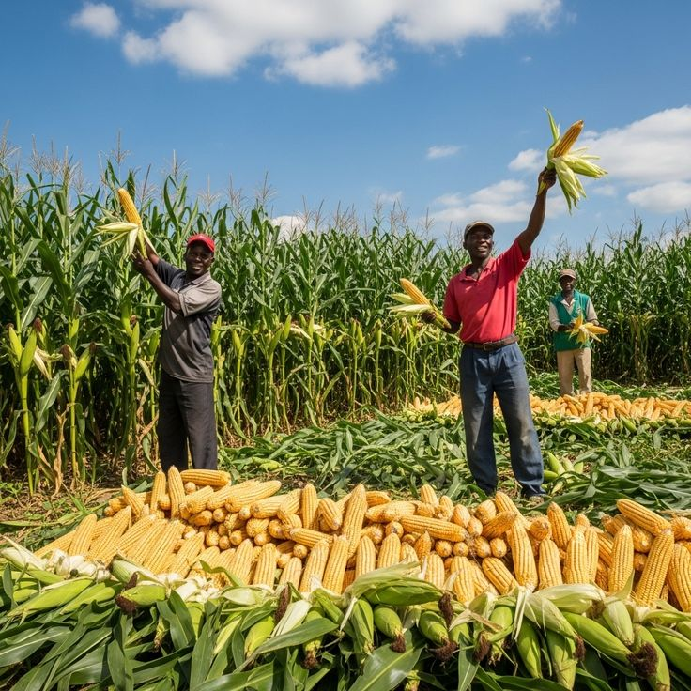
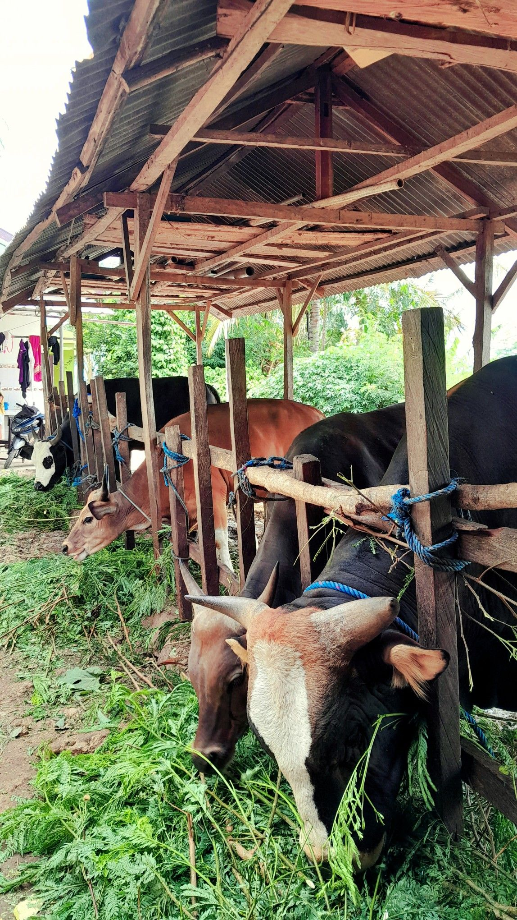
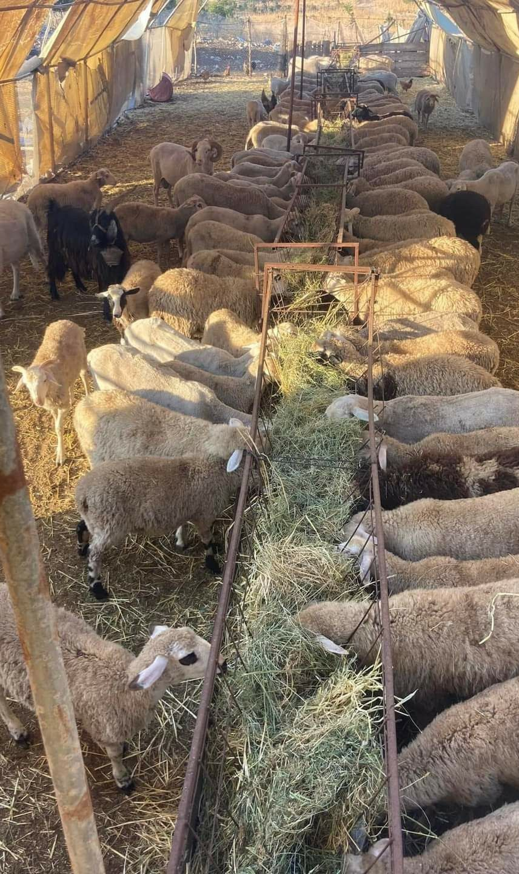
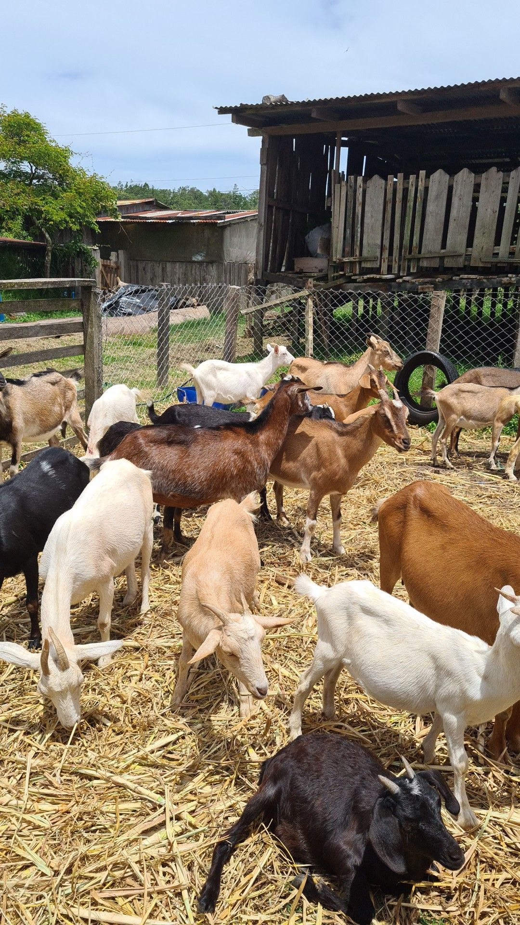
UNIT 3 — FIELD PERSPECTIVE
Feeding and Water Systems
Harvested maize supplies stover and residue for feed
Cattle fed fresh browse under a simple covered shelter
A flock feeds from a raised trough inside a covered pen
A herder waters cattle at a shared dry-season water point
Goats housed in a simple raised shelter near the homestead
Housed feeding, trough design, and dry-season water access for herds and flocks
37

Slide 21
Comparing Grazing Management Systems
Table— Suitability under climate change conditions
Grazing System | Description | Climate Suitability
Continuous grazing | Animals graze the same area year-round | Poor — accelerates degradation under drought
Seasonal rotational | 2–4 paddocks rotated each season | Moderate — better than continuous
Short-duration rotation | 6–12 paddocks, short grazing & long rest | Good — high recovery; best for variable rainfall
Deferred grazing | Rest during growing season; graze dry season | Good — protects plant regeneration
Silvopastoral system | Trees integrated into grazing land | Excellent — shade, fodder, carbon storage
15

Slide 22
UNIT 3
Feed and Water Management
Building resilience through conservation, diversification, and smart water use

Slide 23
Feed Conservation: Hay vs. Silage
The most cost-effective buffer against seasonal feed shortages
 | Hay Making | Silage
Process | Sun-dried to <15% moisture | Fermented in anaerobic (oxygen-free) conditions
Common materials | Maize stover, sorghum straw, cowpea haulms | Maize, sorghum, or Guinea grass
Nutrient retention | 70–80% of original value | Up to 90% of original value
Storage duration | One dry season | 1–3 years
Best for | Bridging a 4–6 week forage gap | Prolonged drought periods
Even modest hay reserves of 1–2 tonnes per livestock unit can bridge a significant forage gap during drought — low-cost pit silos make silage feasible even for smallholder farmers.
18

Slide 24
Feed Conservation: Hay and fodder

Slide 25


Drought-Tolerant and Alternative Feed Resources
Crop Residues
Browse Plants & Trees
Millet, sorghum, cowpea residues; urea treatment (2–4% solution) boosts protein and digestibility
Acacia, Prosopis, Moringa, Leucaena provide leaf fodder when grasses are dry; Moringa is exceptionally high in protein
Agro-industrial By-products
Legume Forage Crops
Cottonseed cake, groundnut cake, wheat bran, brewery waste provide concentrated protein/energy
Stylosanthes, Lablab, Cowpea provide high-protein dry-season fodder and fix soil nitrogen
19

Slide 26
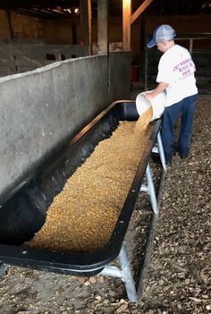
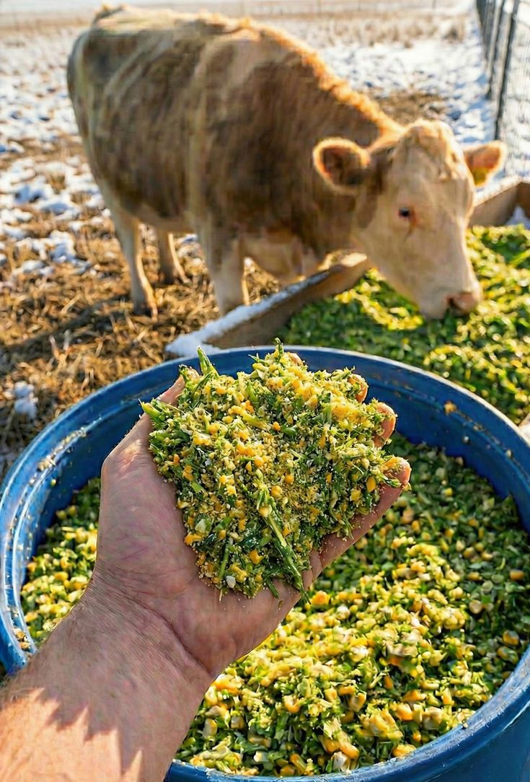
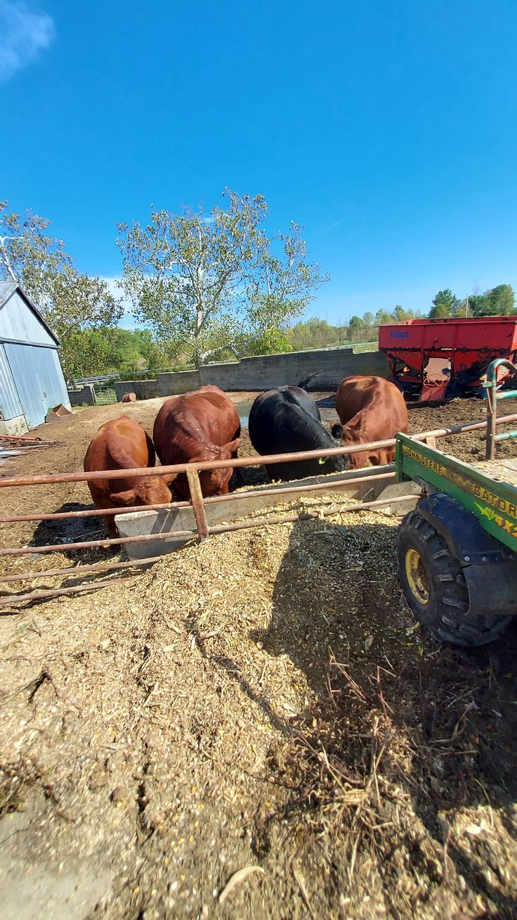
Drought-Tolerant and Alternative Feed Resources

Slide 27

Feed Formulation Principles & Water Requirements
Feed Formulation Principles
Daily Water Needs
Prioritise animals by class: pregnant/lactating females, young stock, and breeding sires get priority access to quality feed
Balance roughage and concentrate: use concentrates to correct specific deficiencies, not replace roughage
Mineral supplementation: salt licks and bone meal prevent deficiencies common with dry-season roughage
Cattle: 30–60 L/day
Sheep & Goats: 2–6 L/day
Under heat stress: +50–100% increase in requirement
20

Slide 28



Water Conservation, Harvesting, and Reducing Waste
Rainwater harvesting
Boreholes & wells
Hafirs, check dams, and contour bunds extend dry-season water by 2–4 months
Solar-powered pumps provide reliable, low-cost dry-season water supply
Storage tanks
Trough design & placement
Covered tanks near the homestead reduce travel distance and heat stress
Well-designed troughs and points within 3–5 km of grazing areas reduce waste and overgrazing
21

Slide 29
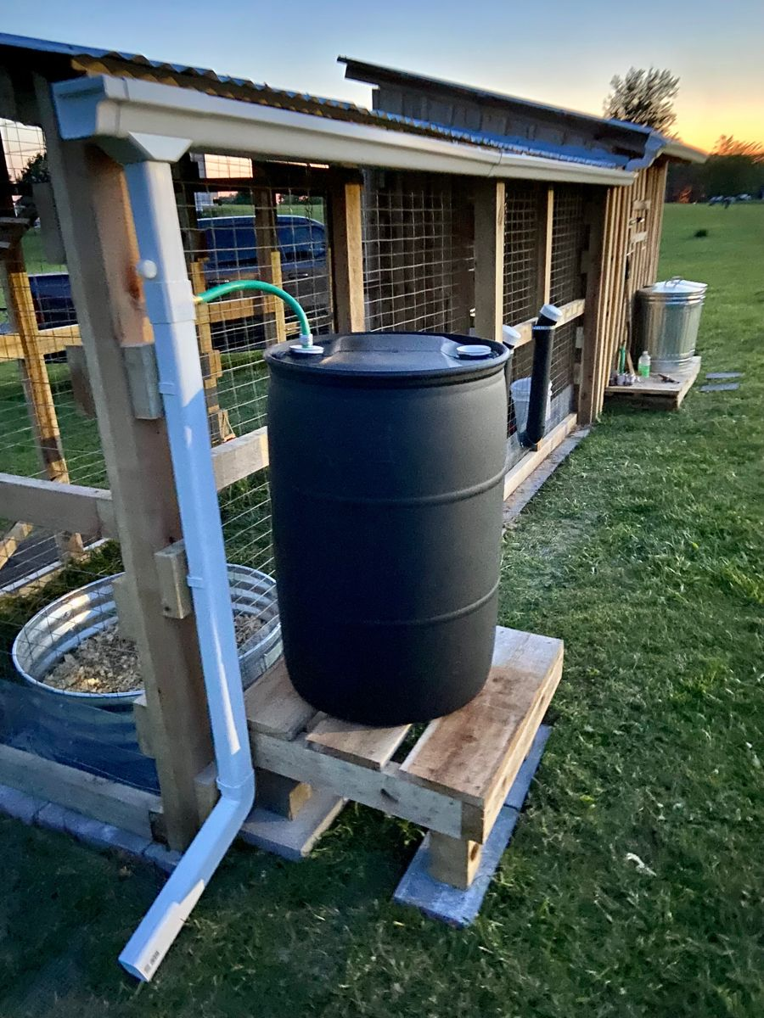
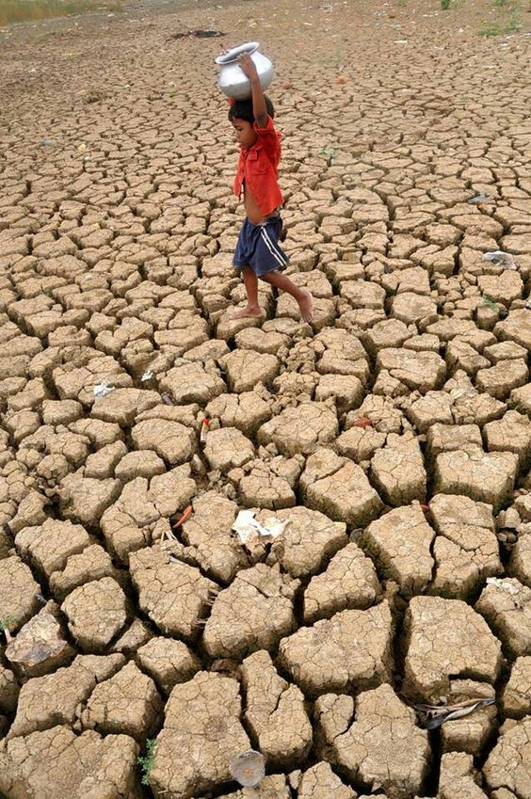
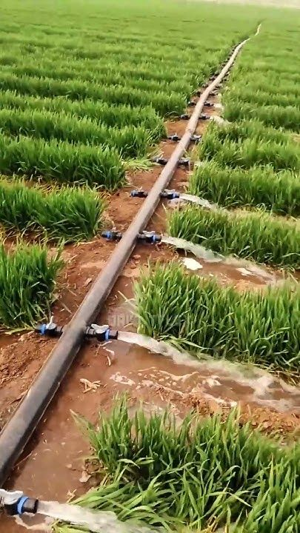
Water Conservation, Harvesting, and Reducing Waste

Slide 30
Feed and Water Strategy Matrix
Table— Strategies matched to specific climate challenges
Challenge | Feed Strategy | Water Strategy
Short dry season (3–4 mo.) | Hay reserves from crop residues; browse grazing | Hafir dams; water troughs
Prolonged drought (>6 mo.) | Silage + agro-industrial by-products; destocking | Borehole with solar pump; water trucking
Heat stress | High-quality early-morning feeding; Moringa supplement | Shade structures; cool fresh water twice daily
Flooding / waterlogging | Elevated feed stores; mould-prevention | Elevated water points; covered storage tanks
22

Slide 31
UNIT 4
Environmental Stewardship
Responsible resource management for long-term ecological and economic sustainability

Slide 32
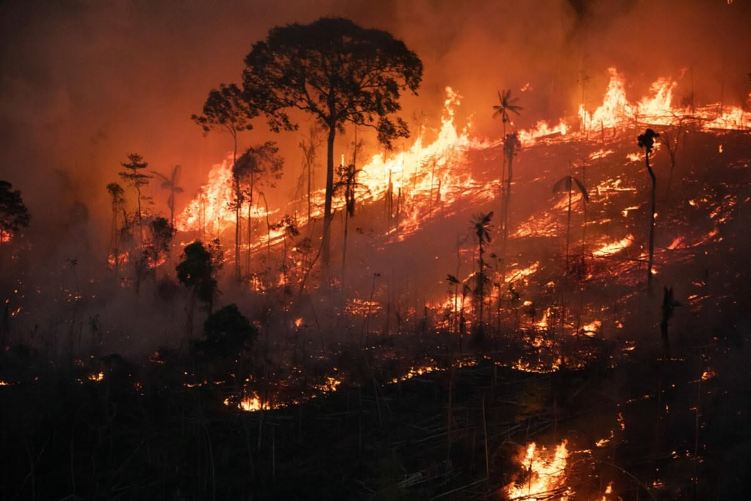
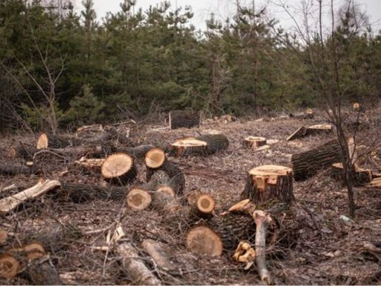
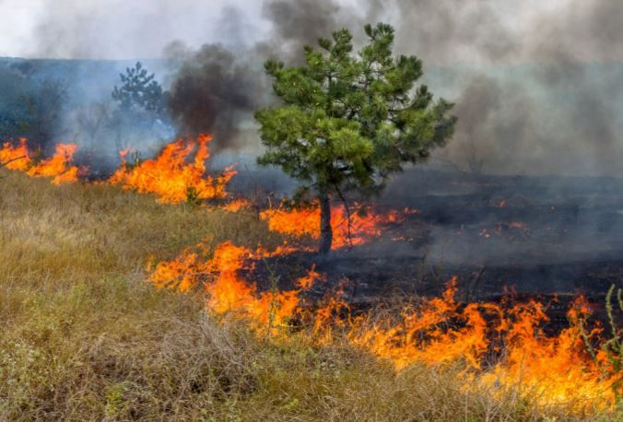

Slide 33
Livestock and Greenhouse Gas Emissions
A responsibility, and an opportunity for improved efficiency
Livestock systems account for approximately 14.5% of all anthropogenic greenhouse gas emissions globally (FAO).
A single cow produces approximately 70–120 kg of methane per year — a gas ~28× more warming than CO₂ over 100 years.
The goal is not to eliminate livestock, but to improve environmental efficiency: more protein per unit of emissions, land, and water.
25

Slide 34

Reducing Emissions and Managing Manure
Enteric Methane Reduction
Manure Management
Improved feed quality: more digestible feed reduces methane per kg of product
Reduce unproductive animals: culling non-productive stock lowers the herd's methane footprint
Improved breeds: high-producing animals emit less methane per unit of output
Composting: manure + crop residues → stable, pathogen-free fertiliser that sequesters carbon
Biogas production: small digesters convert manure into clean cooking gas plus nutrient-rich slurry
Direct application: improves soil organic matter and reduces synthetic fertiliser costs
26

Slide 35

Soil, Land and Water Conservation
Contour farming & bunding
Minimum tillage
Low earth banks along slopes slow runoff and reduce erosion
Preserves soil structure and organic carbon in crop-residue areas
Shelter belts & windbreaks
Protecting water quality
Rows of trees/shrubs reduce wind erosion and provide shade
Fence riparian areas; manage dip-tank chemical waste away from water bodies
27

Slide 36
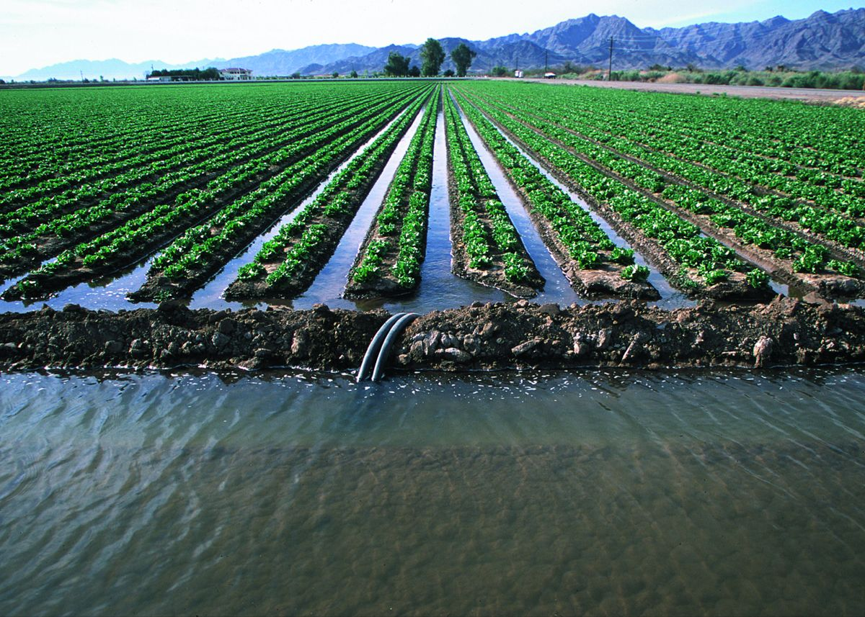
Soil, Land and Water Conservation

Slide 37
Biodiversity Conservation on Livestock Farms
Diverse farms are resilient farms
Maintain mixed-species herds: cattle, sheep, and goats graze at different heights and prefer different plants, utilising a broader vegetation range.
Protect on-farm trees: native trees provide shade, dry-season fodder, nesting habitat, and anchor soil against erosion.
Avoid bush burning: uncontrolled burning destroys organic matter, kills soil organisms, and eliminates habitat for beneficial species.
Biodiversity in pasture species, trees, and mixed herds improves both climate resilience and ecological sustainability.
28

Slide 38


Innovation & Digital Transformation
ICT is reshaping livestock production, value chains, and cooperative governance
Transparent transactions
Traceability
Digital milk collection systems eliminate disputes and ensure accurate payments
Unique animal ID (e.g., "Pashu Aadhaar") enables farm-to-consumer tracking
Efficient logistics
Real-time data
GIS-based route optimisation reduces transport costs
ERP platforms give leaders actionable insights for planning
30

Slide 39
Precision Livestock Farming Technologies
Sensors, data analytics, and automation to monitor and manage individual animals
Technology | Application
RFID / Electronic Ear Tags | Individual animal identification and tracking
Activity Monitors | Heat detection, health alerts, feeding behaviour
Automated Milking Systems | Milking automation with data capture
Environmental Sensors | Temperature, humidity, air quality monitoring
GPS / GNSS | Grazing management, virtual fencing
Drones | Pasture monitoring, herd tracking
India's National Digital Livestock Mission has issued over 35.68 crore "Pashu Aadhaar" tags — 12-digit bar-coded tags linking animals to health, breeding, and production records.
31

Slide 40
Module Summary
Unit 1
Climate change causes heat stress, disrupts disease patterns, and reduces feed/water availability across sub-Saharan Africa.
Unit 2
Rotational grazing, appropriate stocking rates, and pasture rehabilitation maintain rangeland productivity under variable climate.
Unit 3
Feed conservation, drought-tolerant resources, and water harvesting help farmers manage seasonal and inter-annual variability.
Unit 4
Responsible manure management, soil/water protection, and biodiversity investment secure long-term sustainability.
32

Slide 41
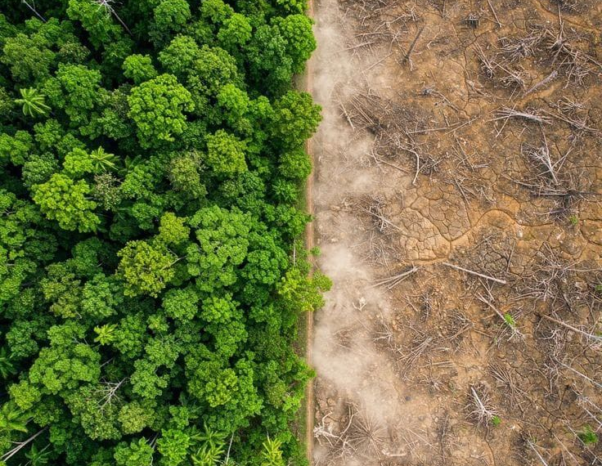
The Cost of Land Degradation
Deforestation and land clearing sharply reduce carbon storage, shade, and biodiversity
38

Slide 42
End of Module
Climate Change Impacts on Livestock, Sustainable Grazing, Feed & Water Management, Environmental Stewardship
YABIRDI -- L_PRESS
Yobe State

